Slide 1
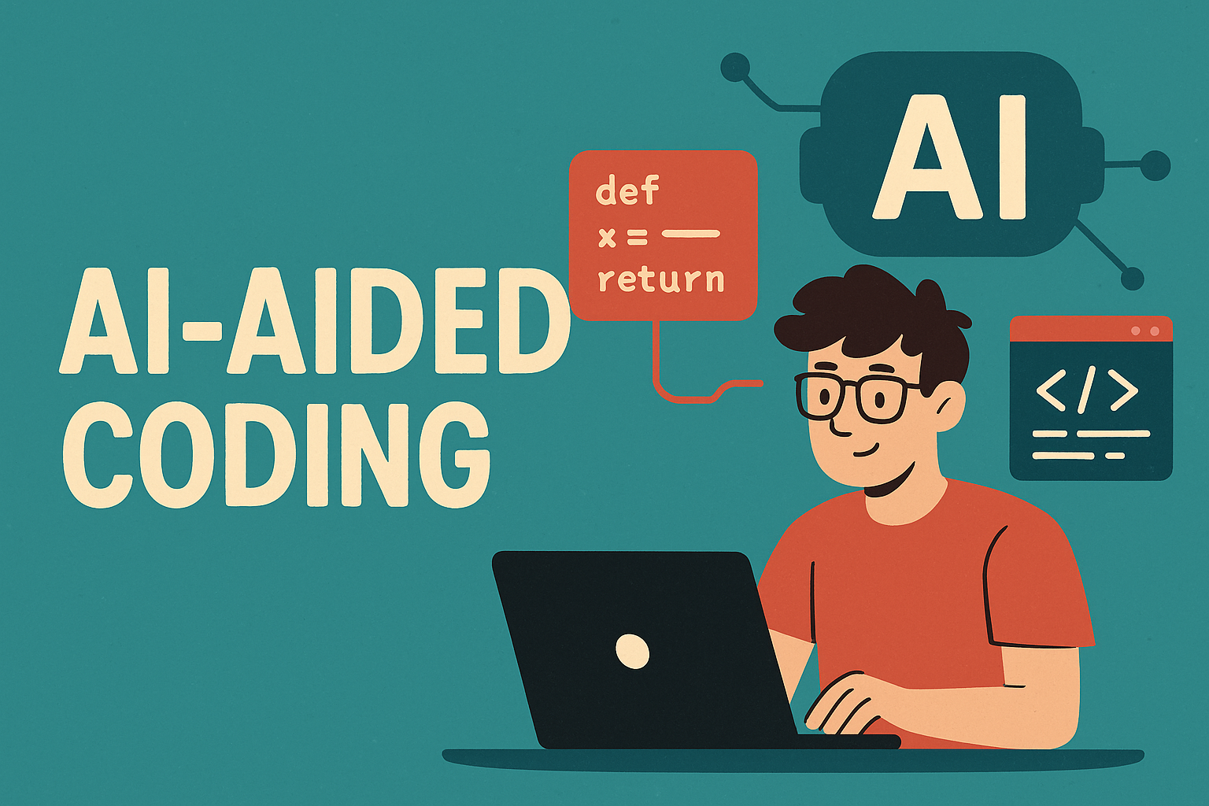

Slide 2

Unlock Coding With AI
AI tools can enhance the coding process significantly.
This presentation explores AI's integration into coding practices.
We will cover CLI and IDE solutions for AI coding.
Practical experiences with different AI models shared today.

Slide 3

Software Engineers Evolve Rapidly
Software engineering roles will drastically change soon.
Future CSE students will quickly adopt AI tools.
Gain this essential knowledge to stay competitive.
AI coding tools are becoming a vital asset.

Slide 4

AI Coding Tools Explode Now
AI coding tools evolved from annoyance to essential support recently.
Tools like Claude, Aider, and Cursor emerged in recent years.
Community innovations led before big model companies did.
The software engineer's future is being redefined now.

Slide 5
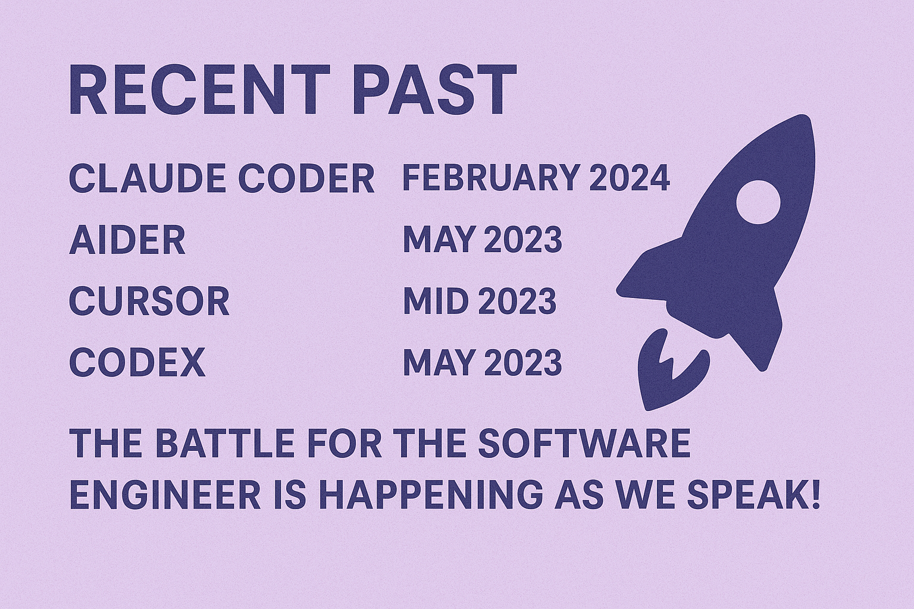
2025
2025

Slide 6
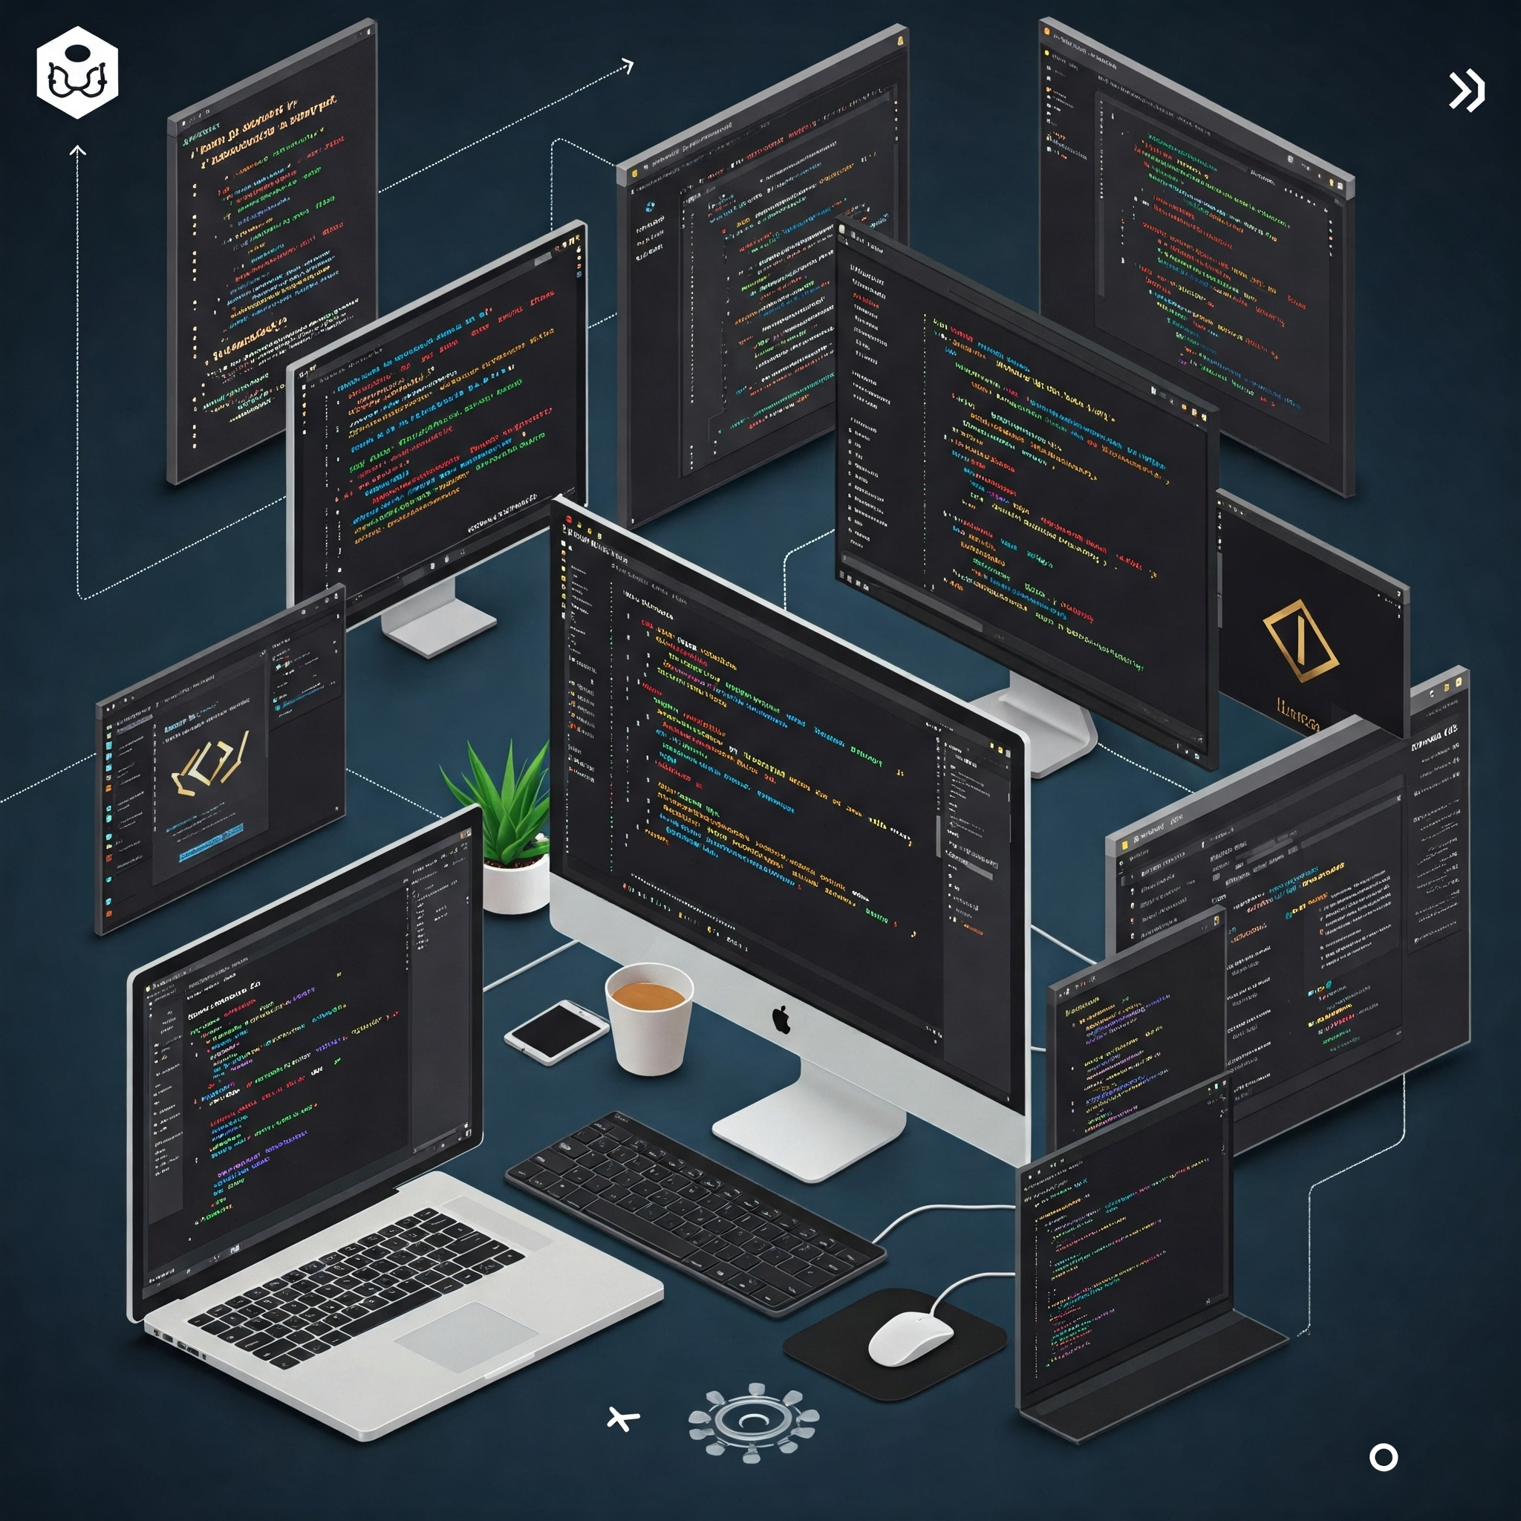
AI Coding Tool Landscape
AI offers both CLI and IDE coding tools.
Aider, Claude, and Codex are key CLI options.
Gemini Code Assist is new to the toolset.
Cursor and Windsurf are AI integrated IDEs.
Jetbrains also offers AI coding features.

Slide 7

Experiences With AI Coders
AI coding tools like Claude Code show promising early results.
Cursor is proving to be a very positive AI coding experience.
Satisfaction with tools is related to the AI models used.
Experiences with specific AI models will be discussed in detail.

Slide 8

AI Coding Tools Comparison
Aider needs mode switches via commands, learning is required.
Claude Code responds to "do not code" requests directly.
Cursor's ask mode tried to modify code anyway.
Cursor requires clicks to apply code changes from chat.

Slide 9
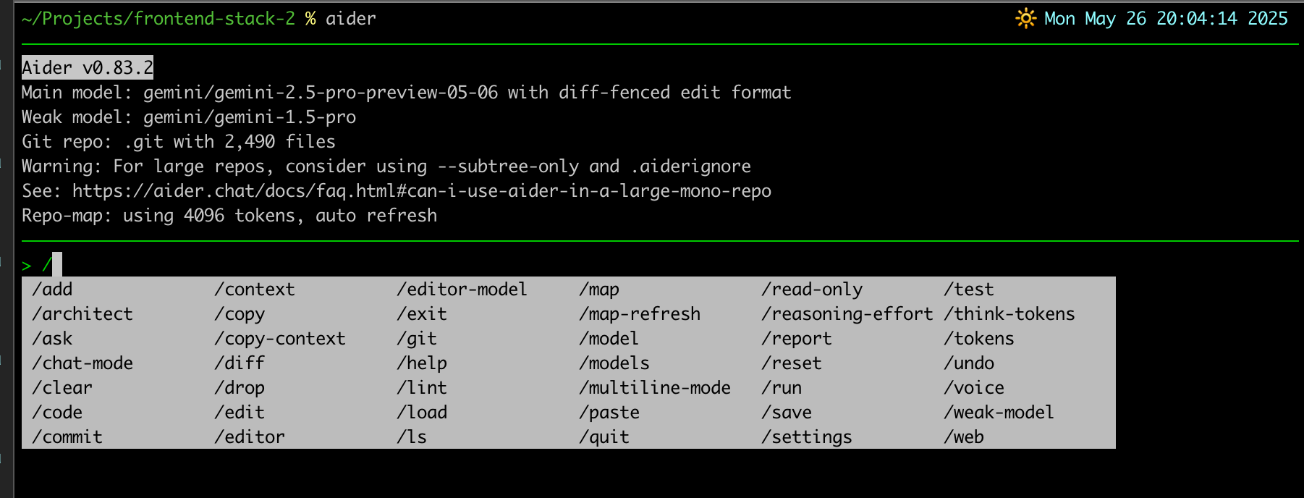
AI Coding Tools Comparison

Slide 10
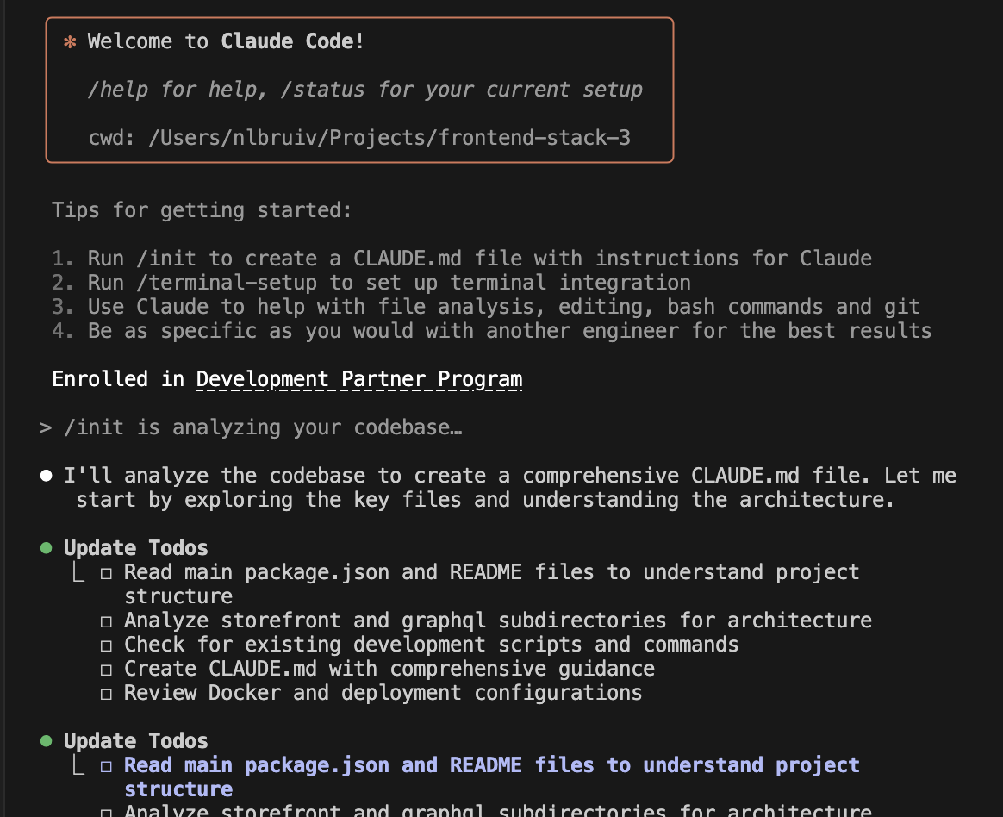
AI Coding Tools Comparison

Slide 11
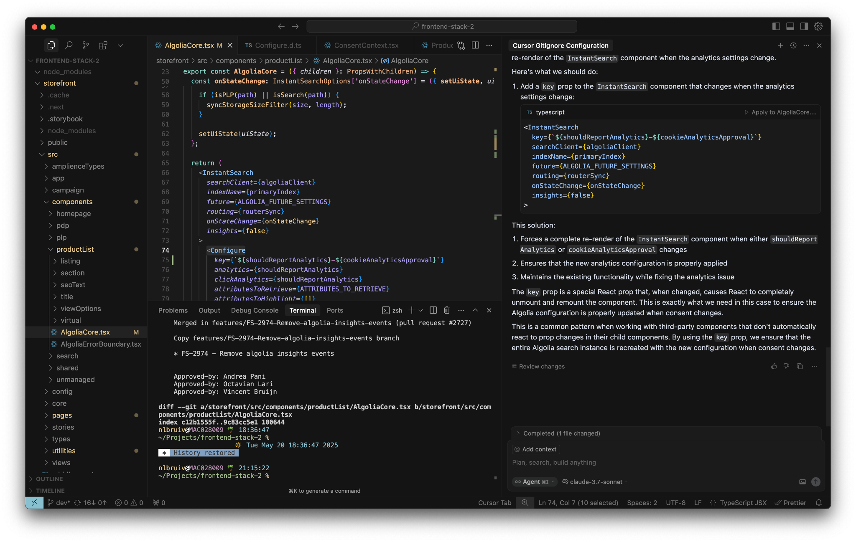
AI Coding Tools Comparison

Slide 12
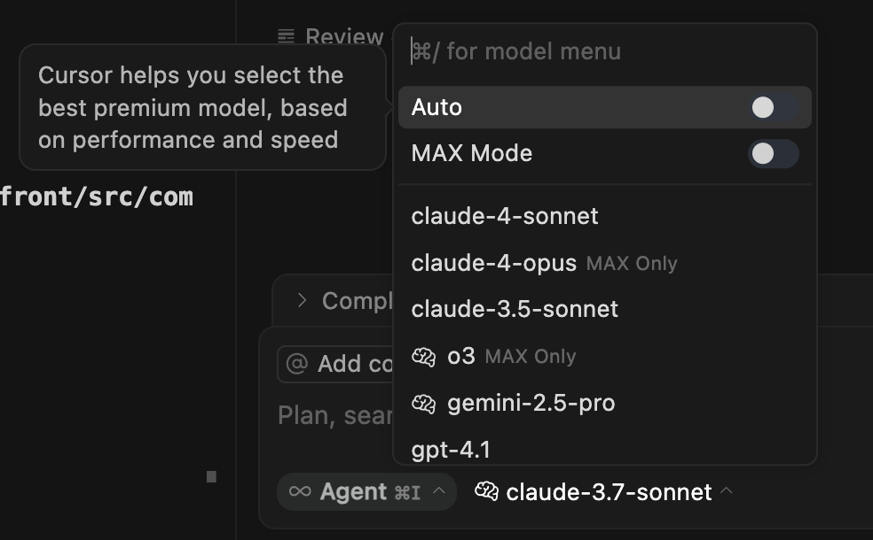
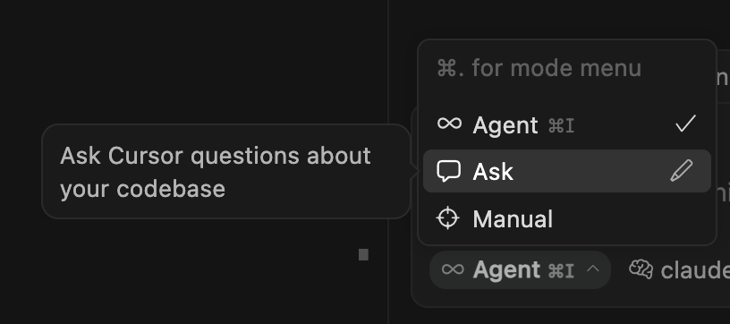
AI Coding Tools Comparison

Slide 13
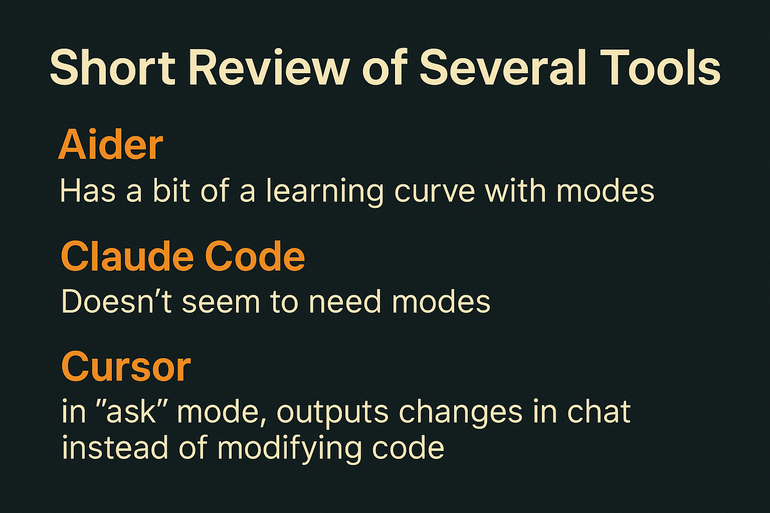

Slide 14

Claude Code: Terminal AI Delight
Claude Code's interface and colors are visually appealing to me.
Real-time feedback from Claude Code is highly beneficial.
It integrates well within VS Code using the terminal.
Requires explicit request to update memory file CLAUDE.md.
Costs are visible within Claude Code, a closed source tool.

Slide 15
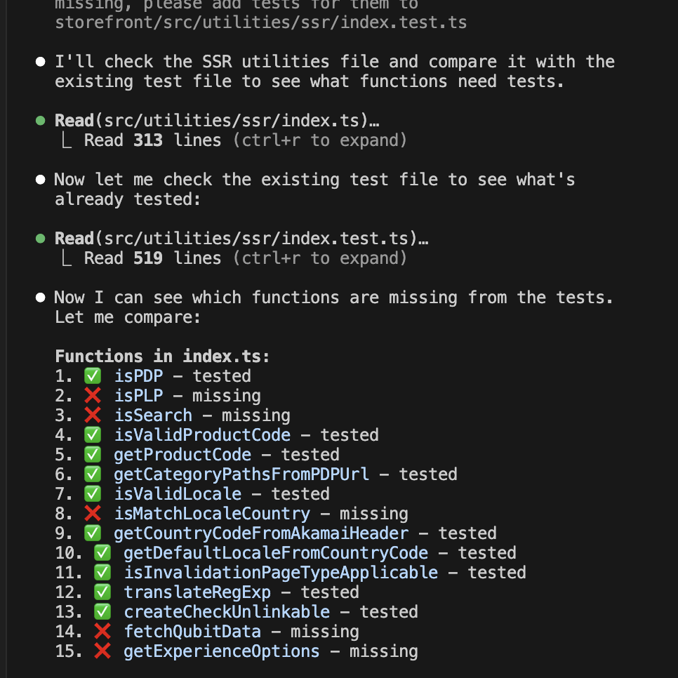
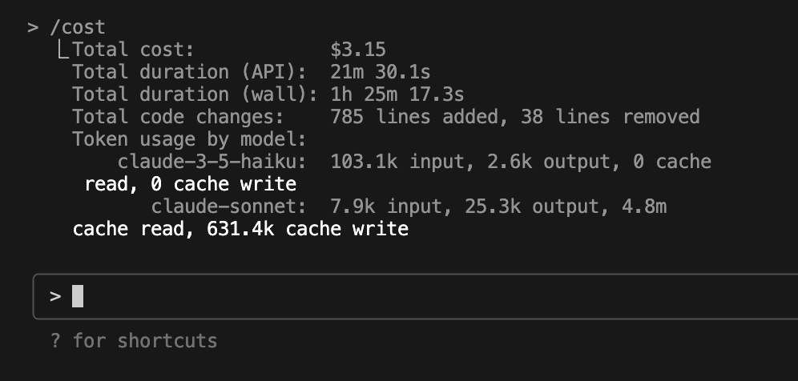
Claude Code

Slide 16
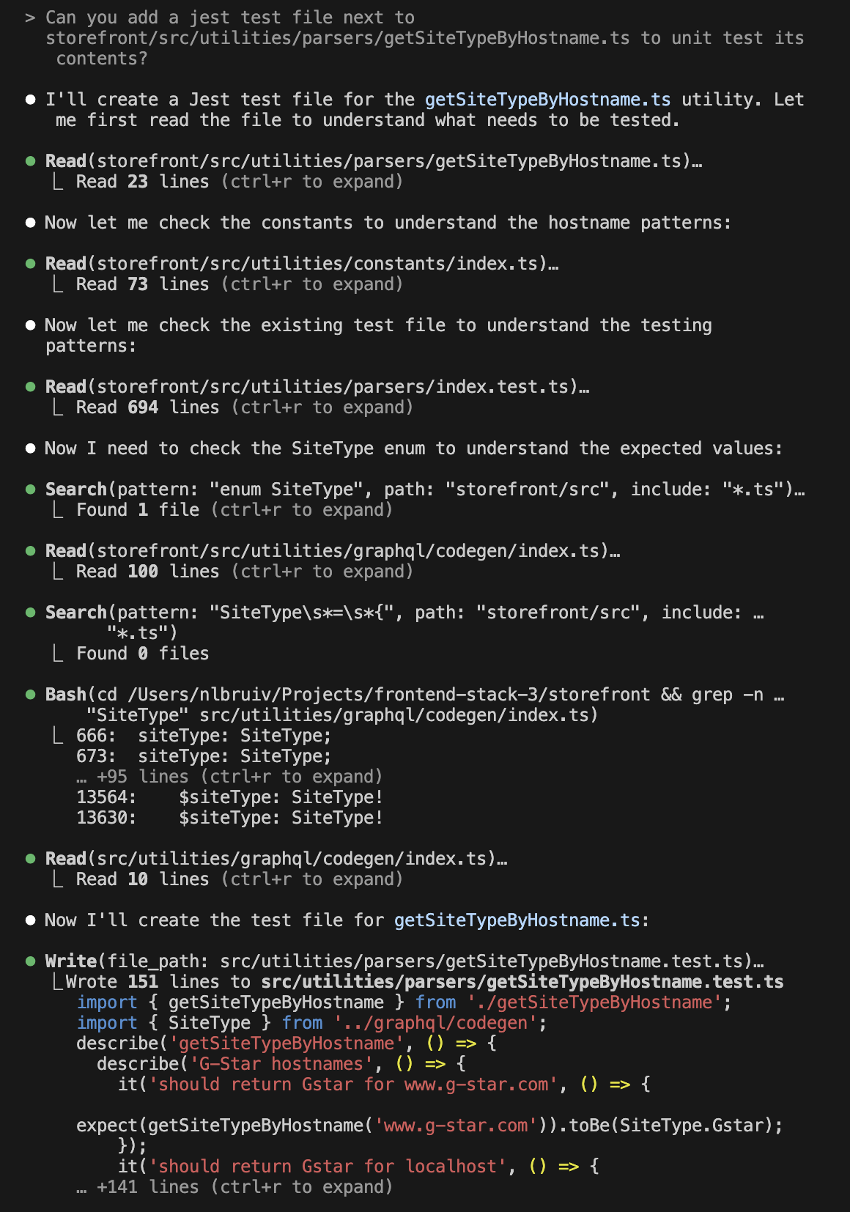
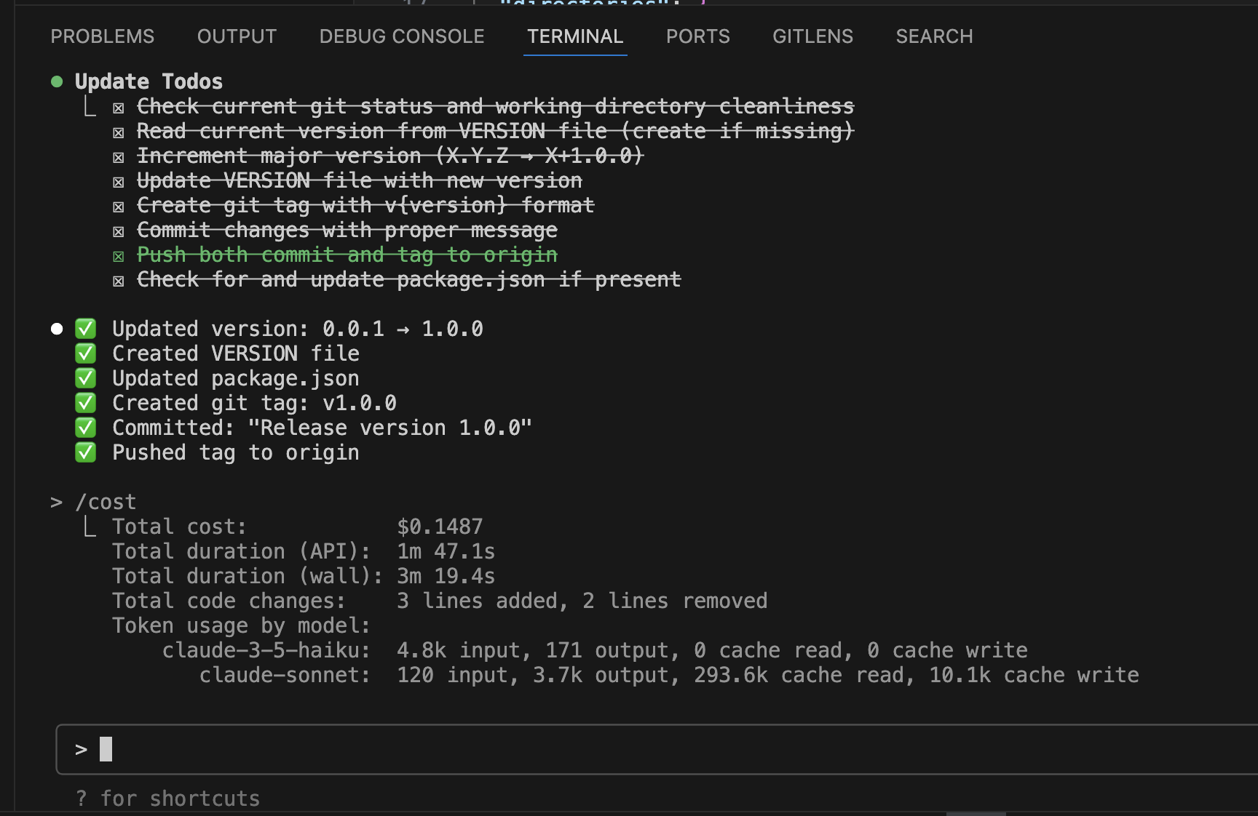
Claude Code

Slide 17

Codex: “Cutting Edge” Dependencies
Codex CLI requires NodeJS 22 for latest technology use.
Codex CLI is model agnostic and uses "providers" like Aider.
Haven’t tried it (yet).

Slide 18
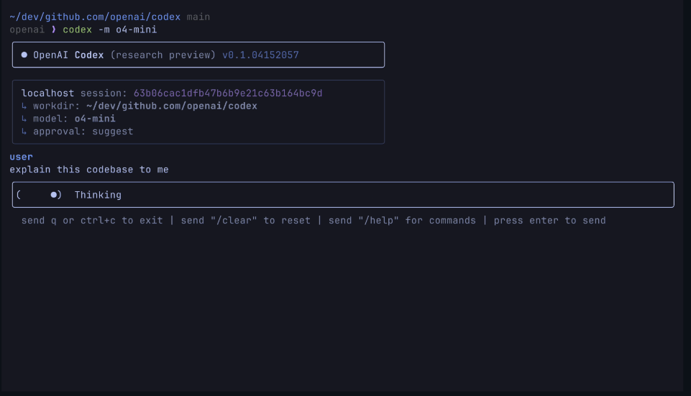

Slide 19
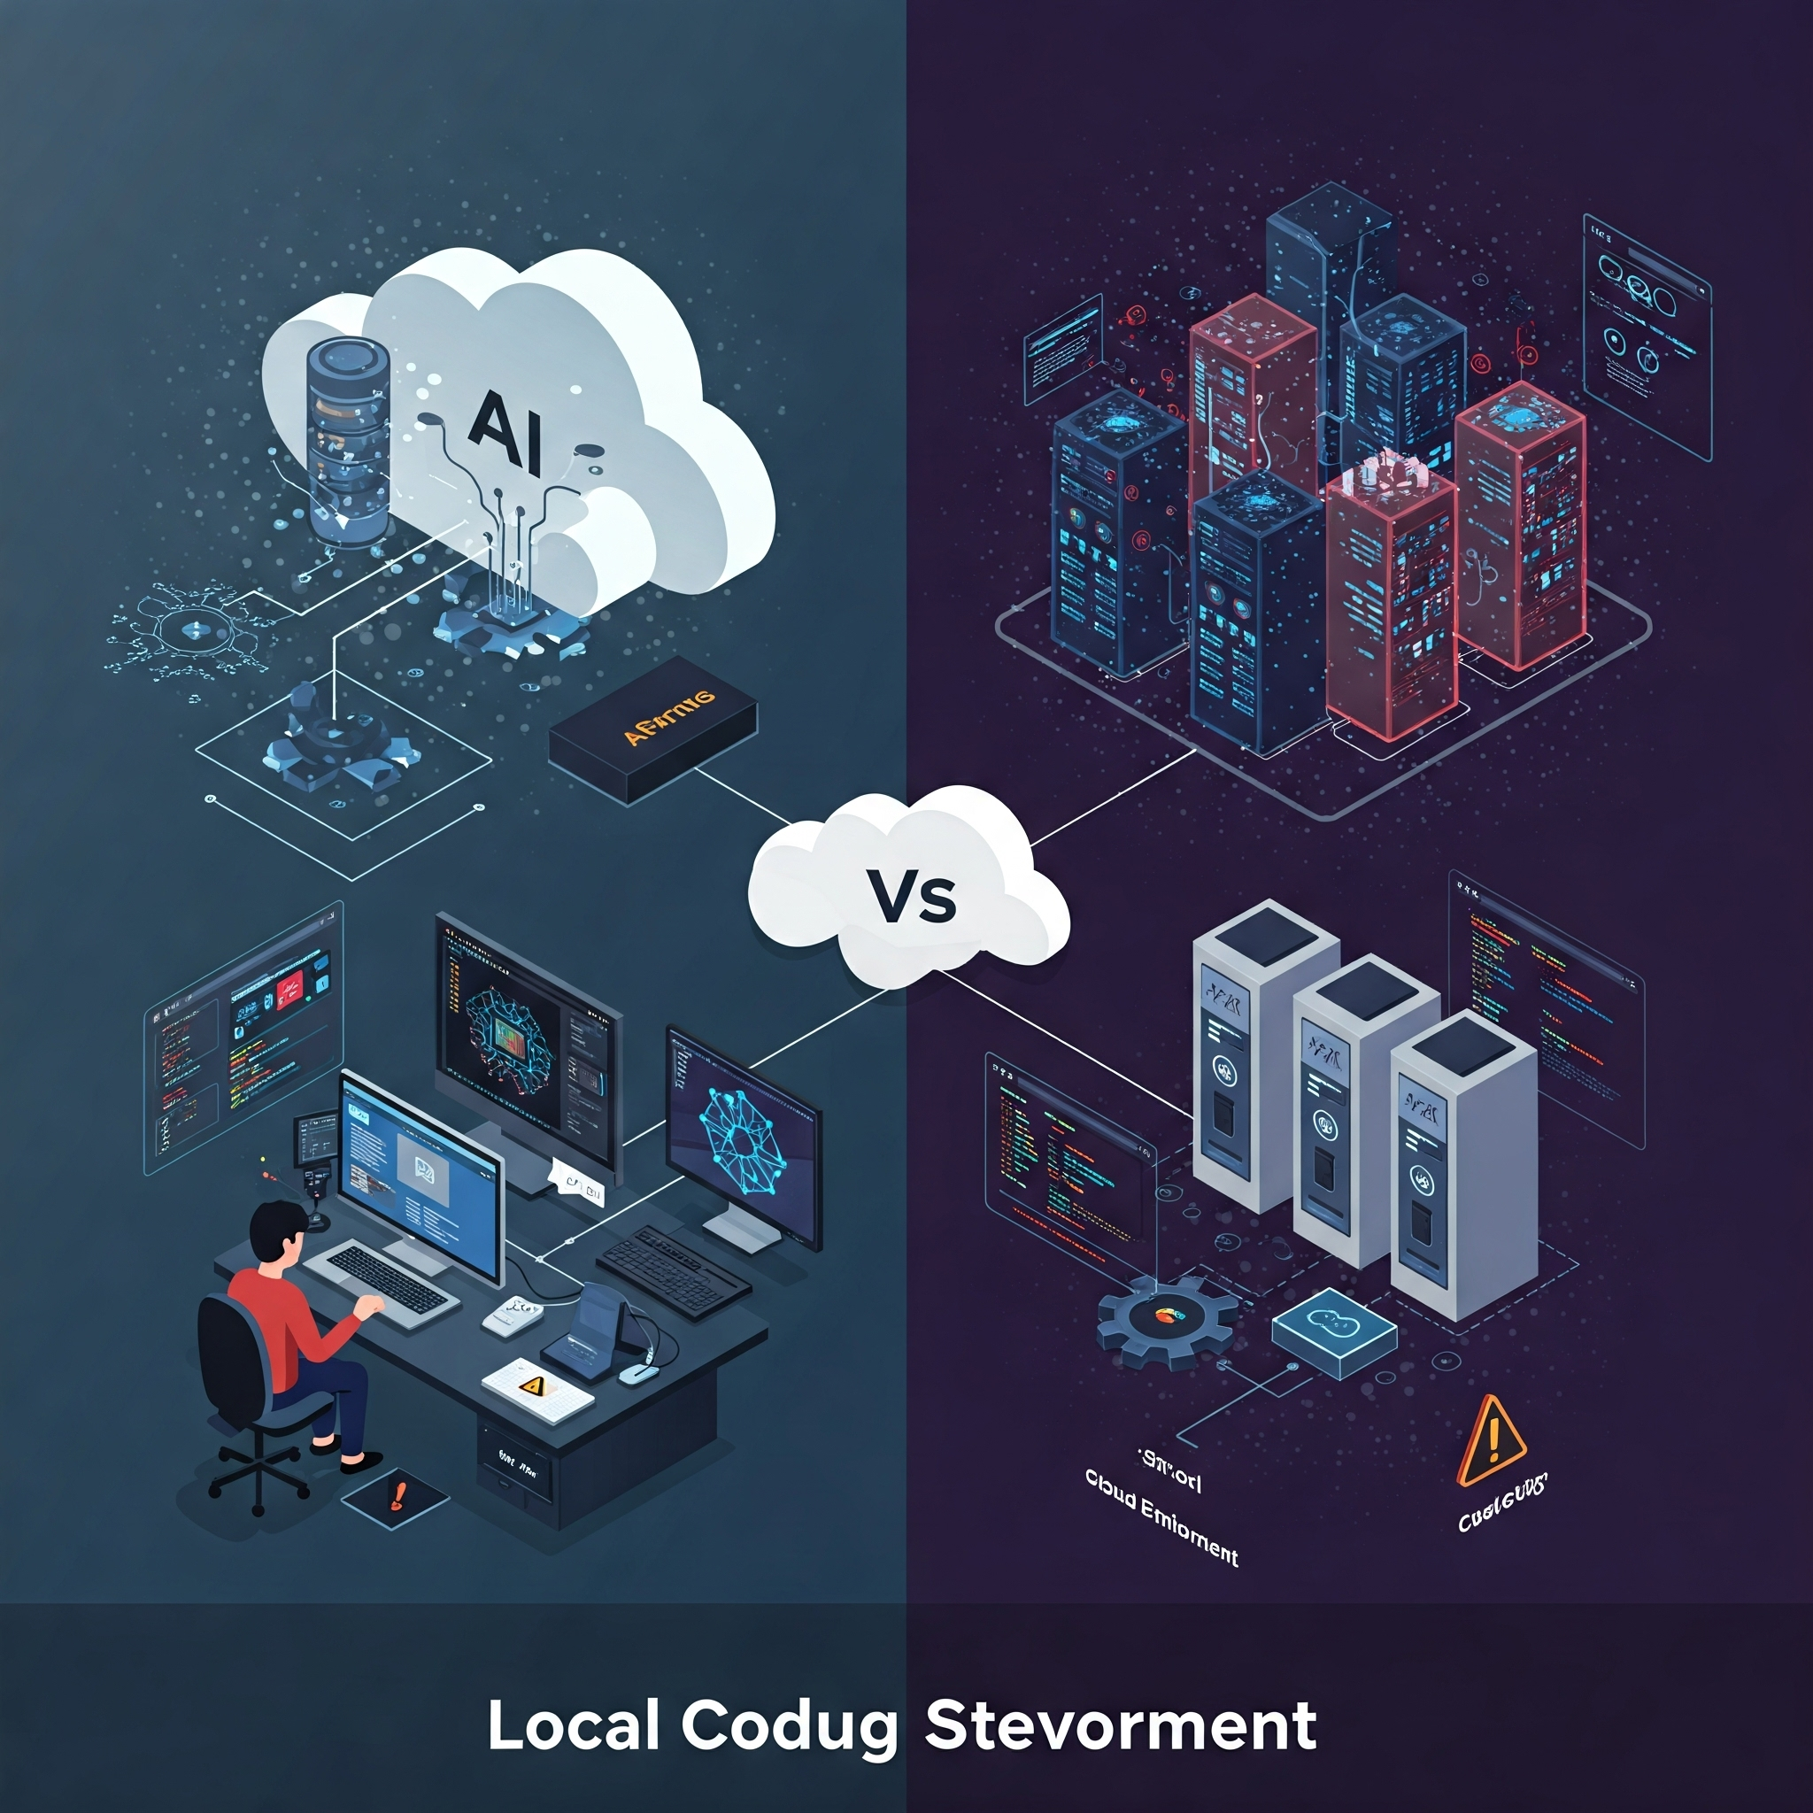
Aider: Local Fail, Cloud Win
Aider with Ollama and Qwen-3 was an attempt at local cheap development.
Qwen-3 hallucinations occurred on my Mac Mini, potentially due to its size.
Aider with Gemini worked well but lacked clear progress feedback.
Aider is developer-focused with environment variables and manual commands.

Slide 20
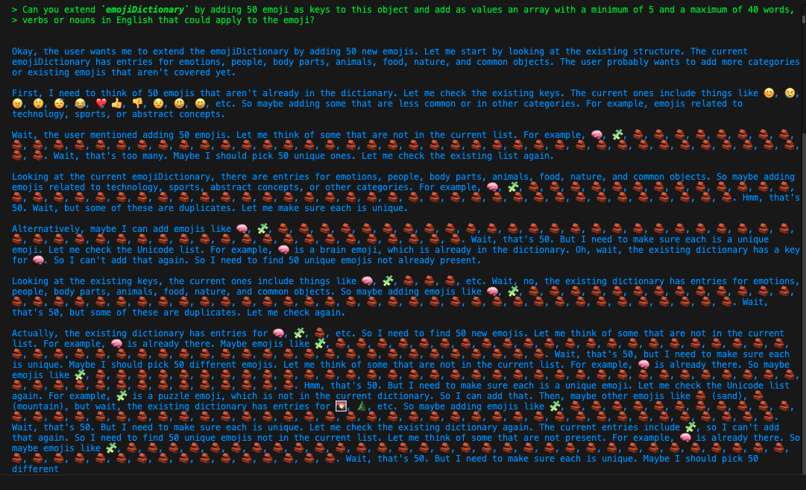
Hallucinations Qwen3

Slide 21

Choose Your AI Coding Models
Claude Sonnet 4
Claude-3.7-Sonnet excels at coding, same as Gemini 2.5 Pro.
ChatGPT-4o is also very good at coding tasks.
Companies use proprietary models to learn company code styles.
Amazon Q Developer is quite adept at Java coding tasks.
JetBrains AI Assistant provides good Java coding support.

Slide 22

Cost-Saving AI Coding Shortcuts
Use chat AIs like ChatGPT for initial coding drafts.
Generate project artifacts like README in AI chats.
Transfer outputs from AI chat to IDEs easily.
Start projects on AI mobile app, sync to desktop.
Creates an index.html/js to quickly get going.

Slide 23


Slide 24

AI Project Overview Limits
Some AI tools build code layout maps for imports.
Most AI assistants lack complete project detail overview for now.
Open relevant files in Cursor for best results.
Chat with AI on open files for issues.

Slide 25
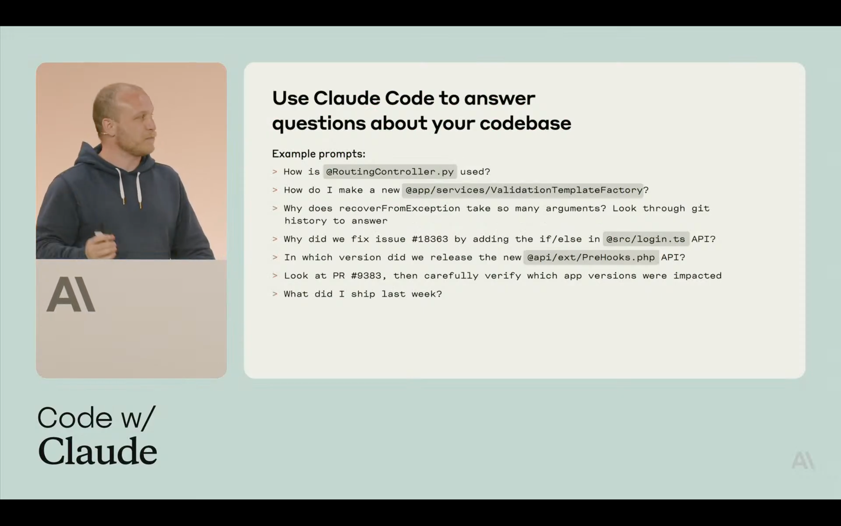

Slide 26
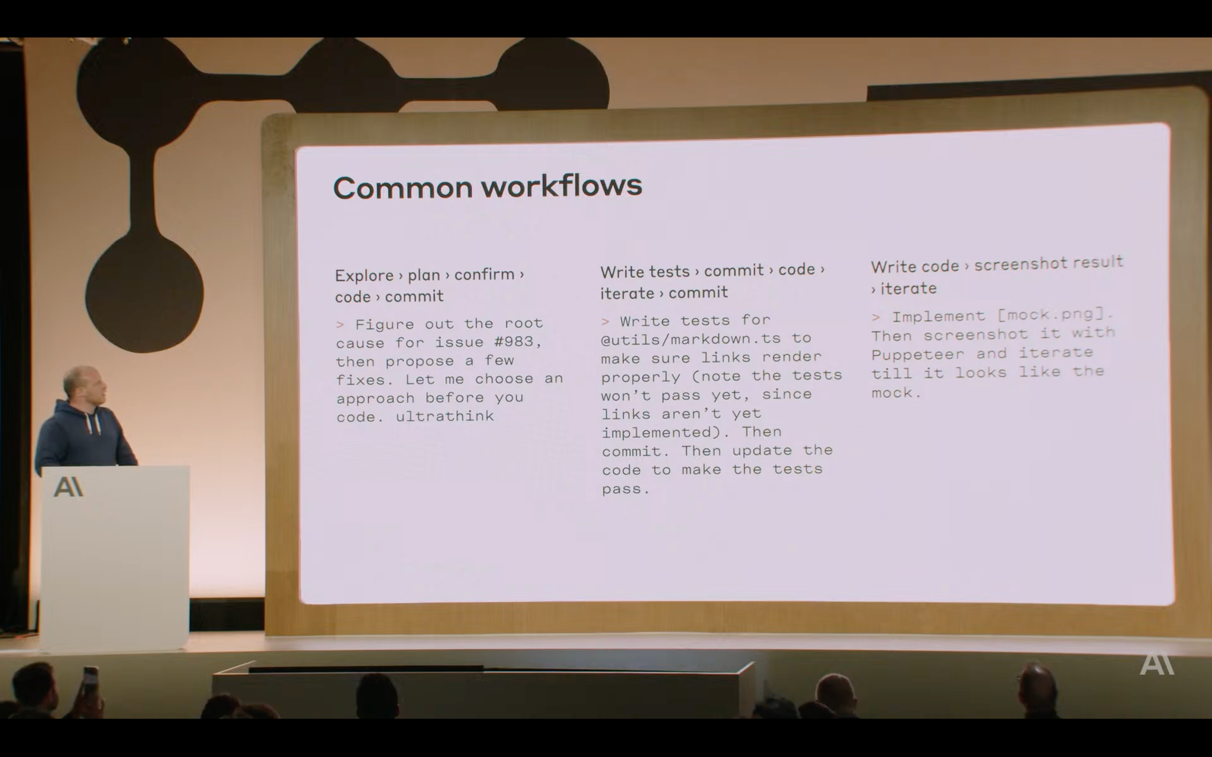

Slide 27
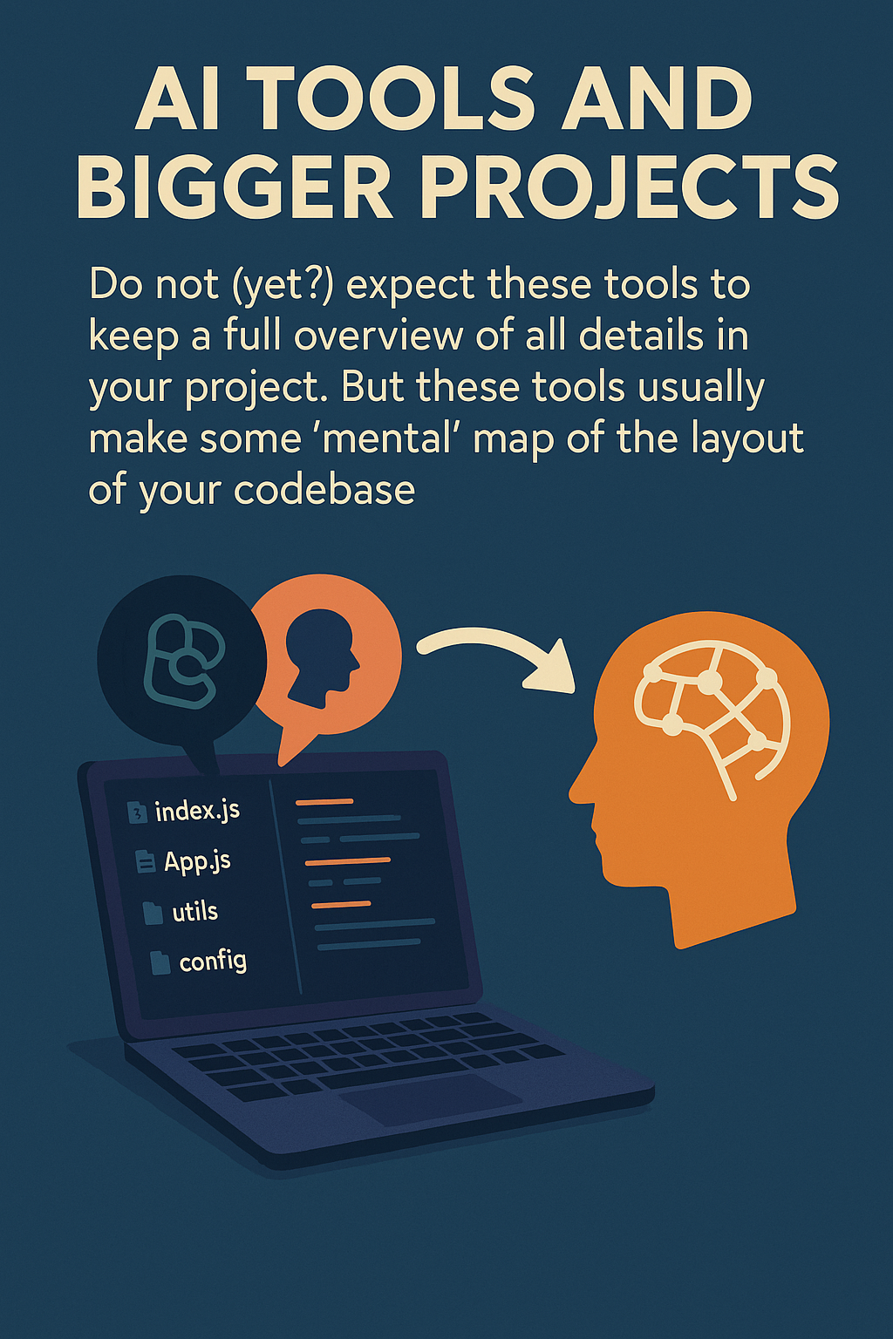

Slide 28

Multi-Model Aider: Select Models
AI tools use various models for different tasks.
Aider uses small models for commits and large ones for coding.
Defining model usage is required within Aider.
Some tools adapt model complexity based on needs.

Slide 29
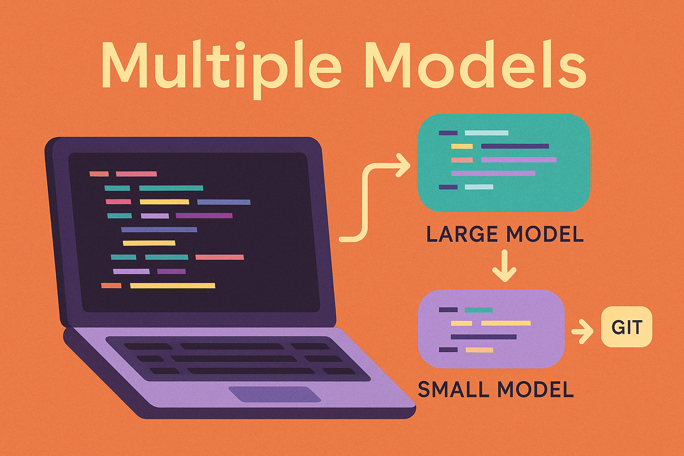

Slide 30

AI Coding: Hallucinations & Precision
AI models may generate incorrect code due to vague prompts.
Provide detailed context instead of generic instructions to AI.
AI can get stuck in loops creating endless files, debug scripts.
Knowing your codebase is key to giving precise AI instructions.

Slide 31
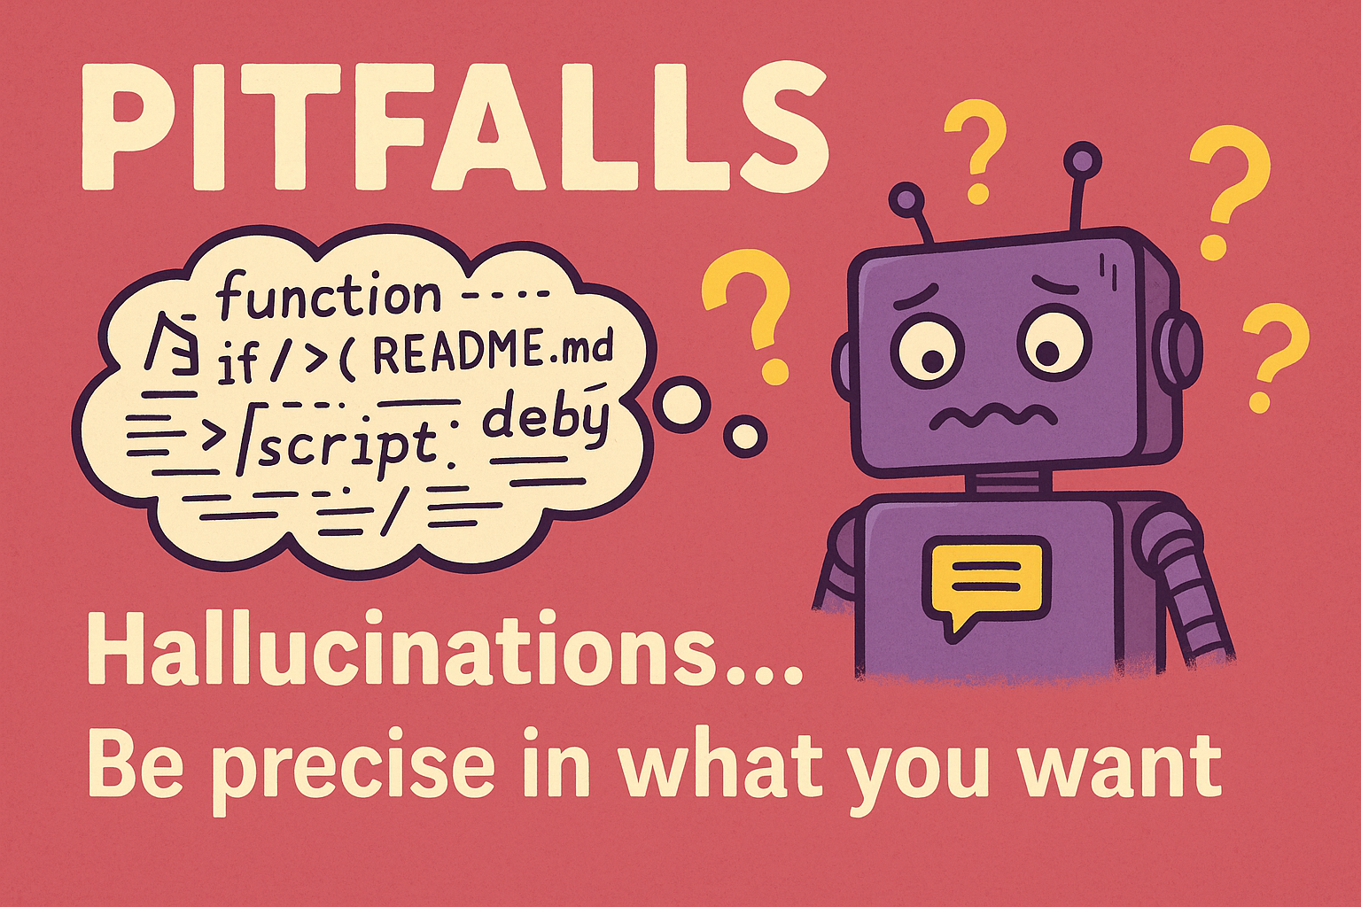

Slide 32
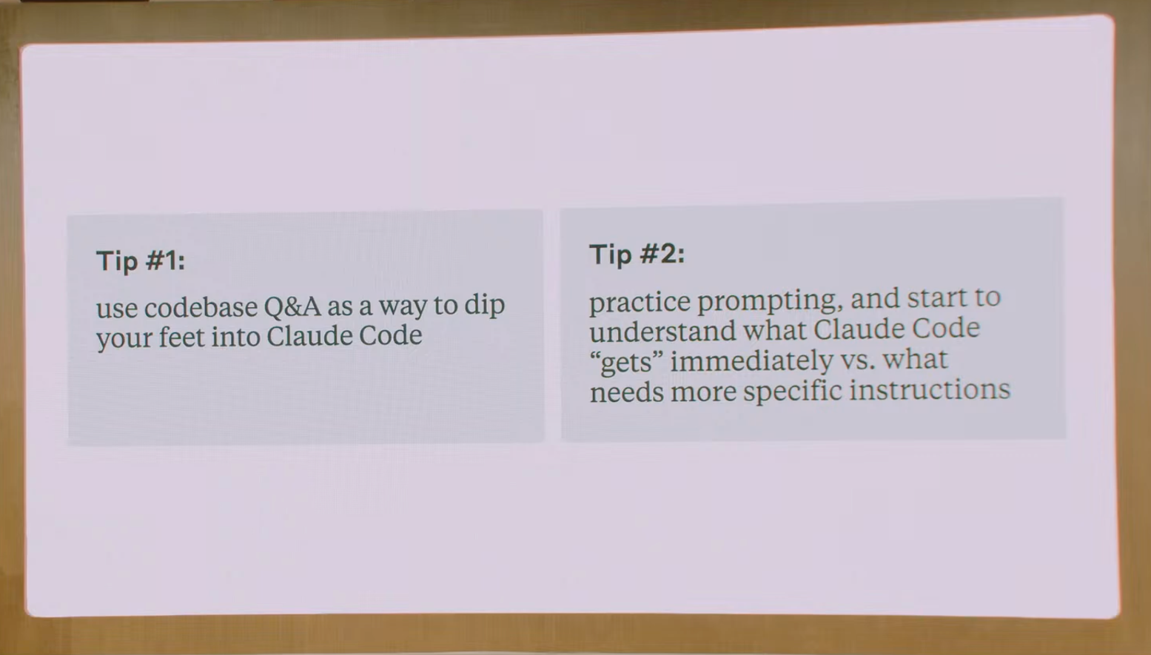
AI Coding Best Practices
Commit code when work feels good enough.
Aider does auto commits, which may feel controlling.
Claude Code needs manual CLAUDE.md memory updates.
Regularly update README.md

Slide 33
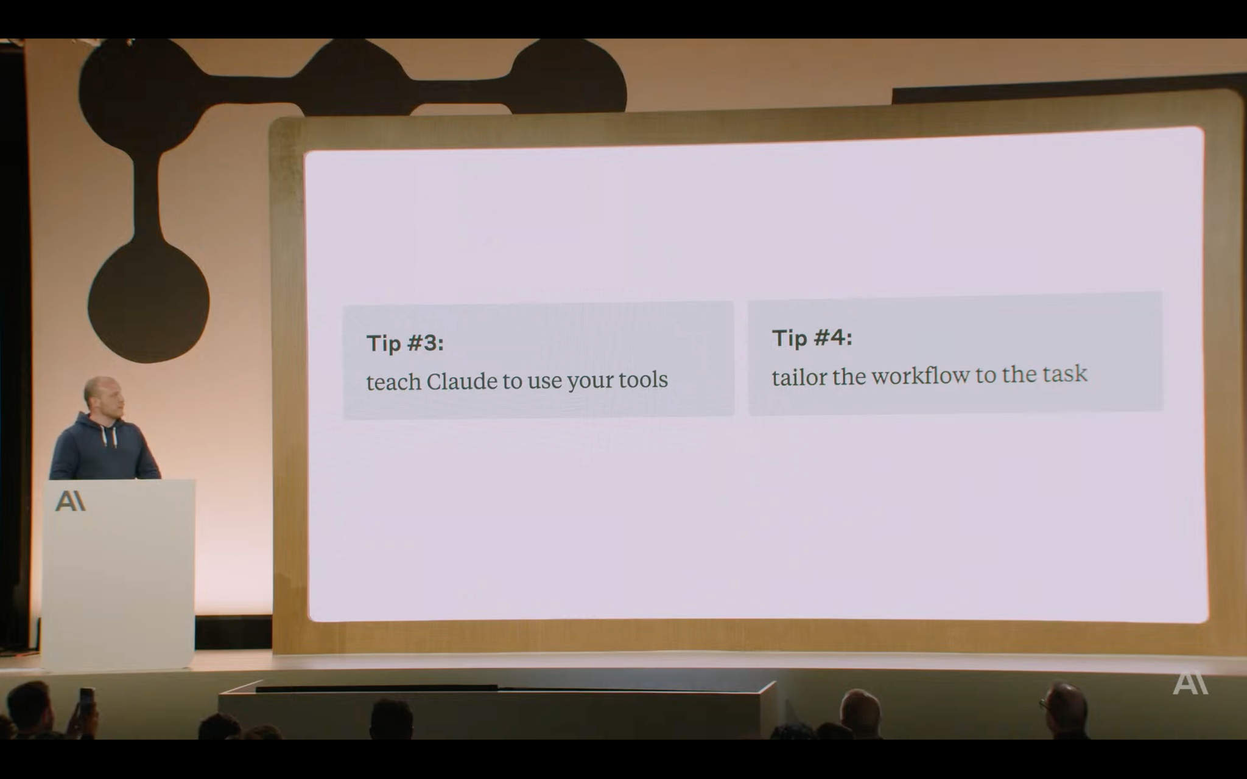

Slide 34
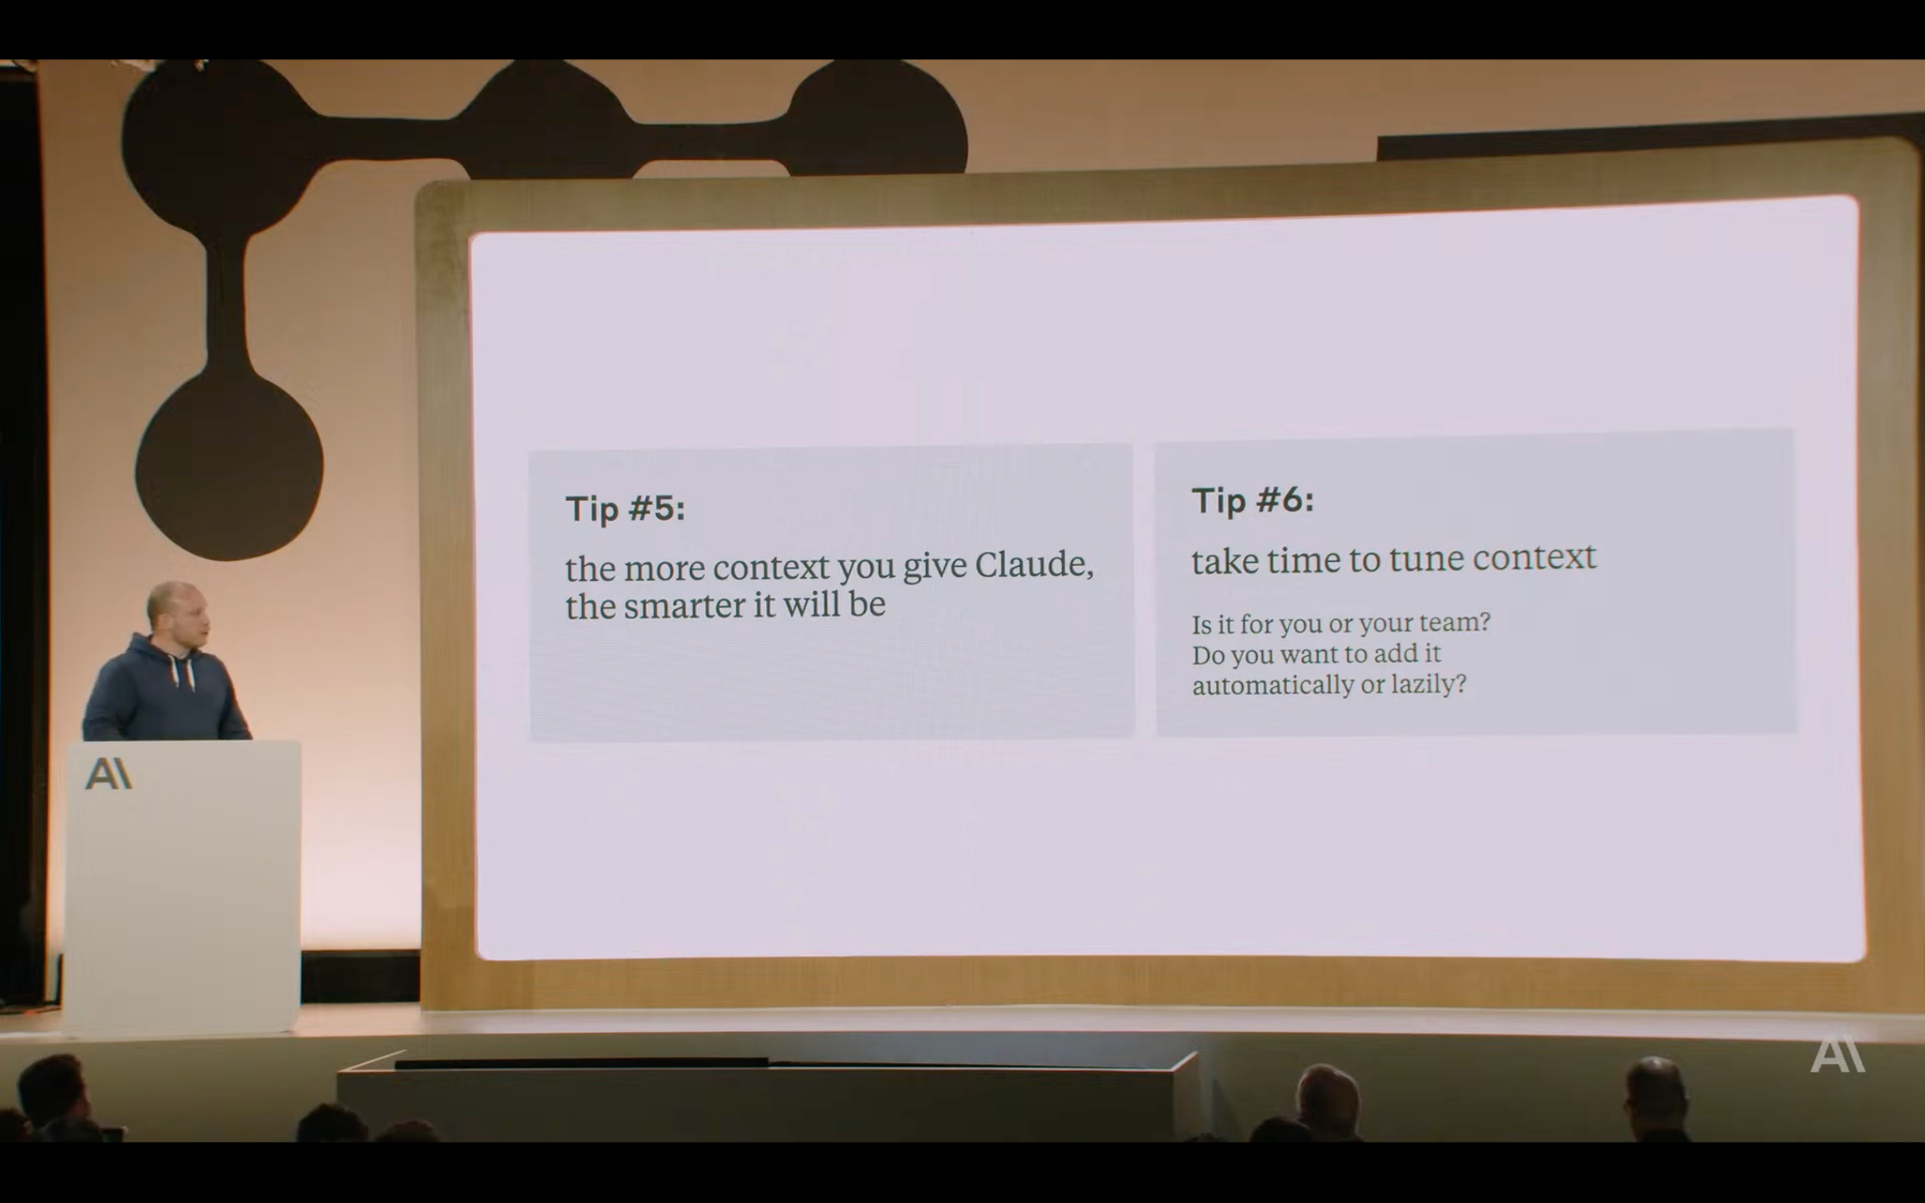

Slide 35
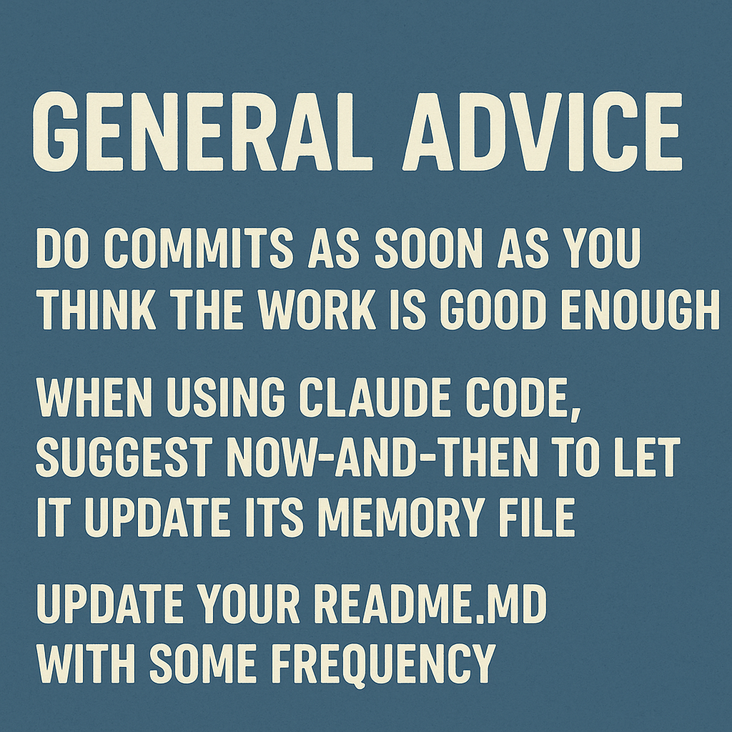

Slide 36
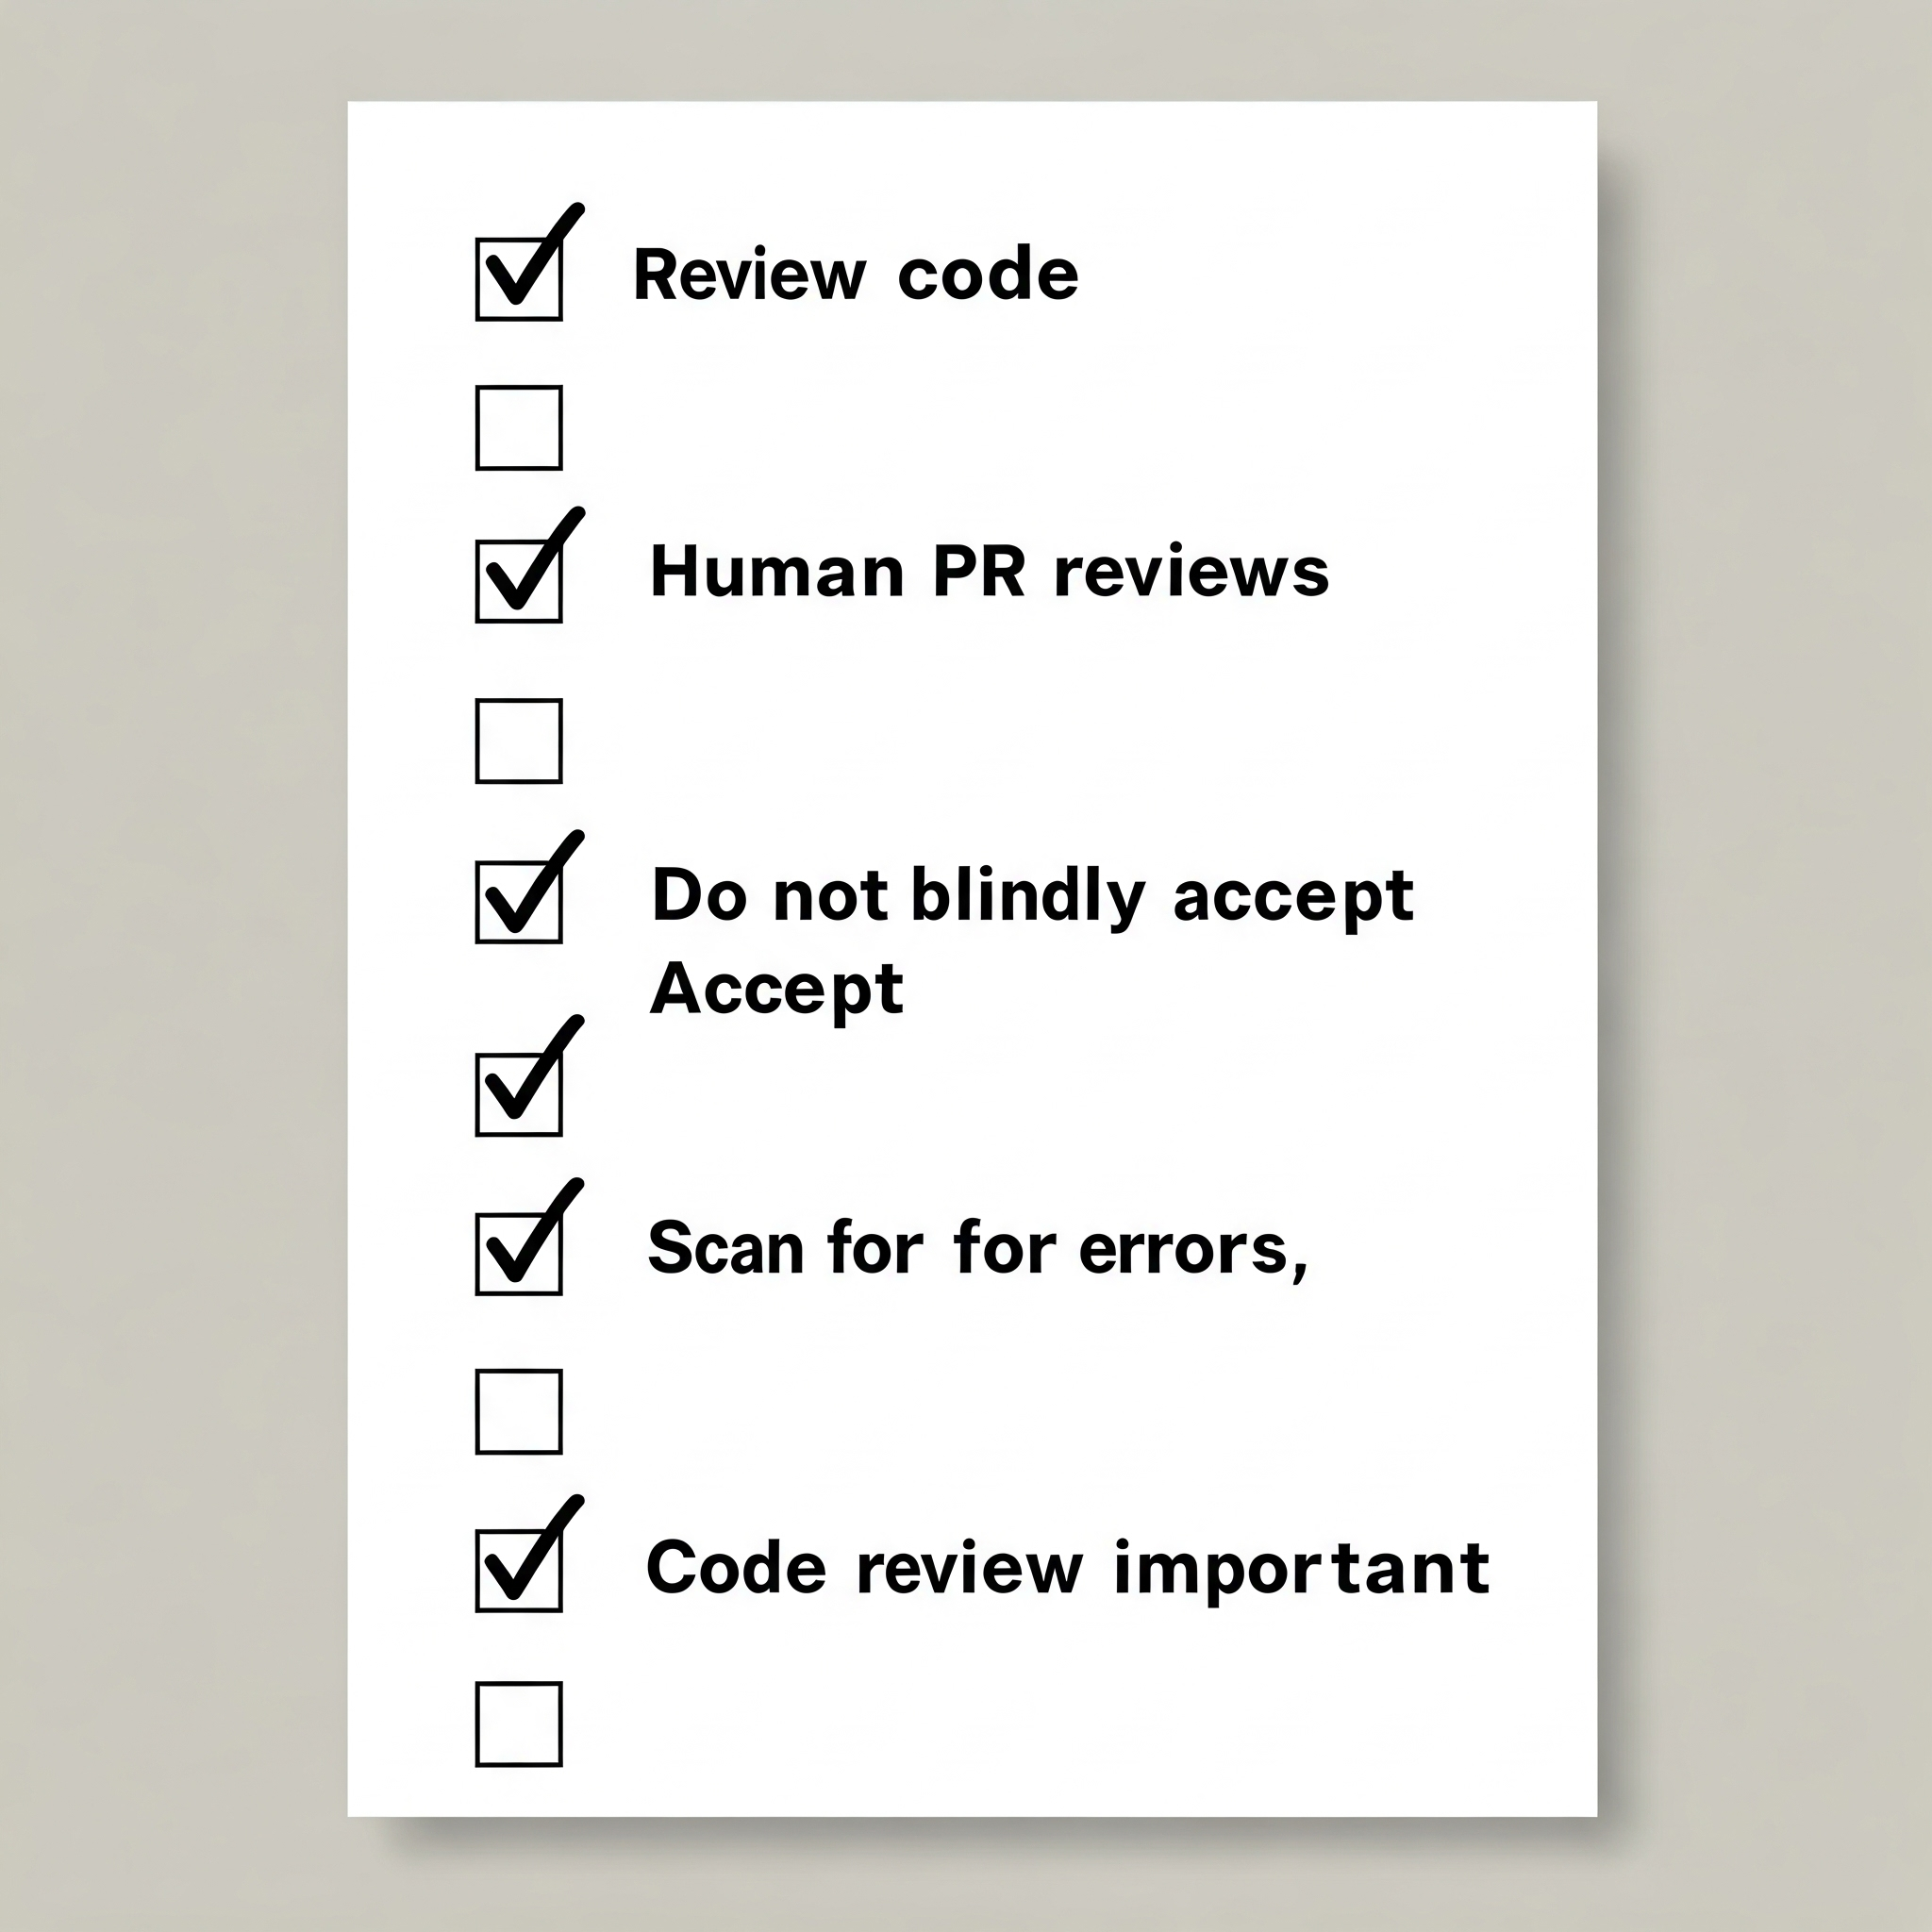
Review Before Accept: AI Code
Always review code changes before accepting from AI.
Human PR reviews remain essential for software development.
Do not blindly accept AI-generated code suggestions ever.
Scan proposed modifications carefully for errors or issues.
Importance of code review by humans is unchanged.

Slide 37
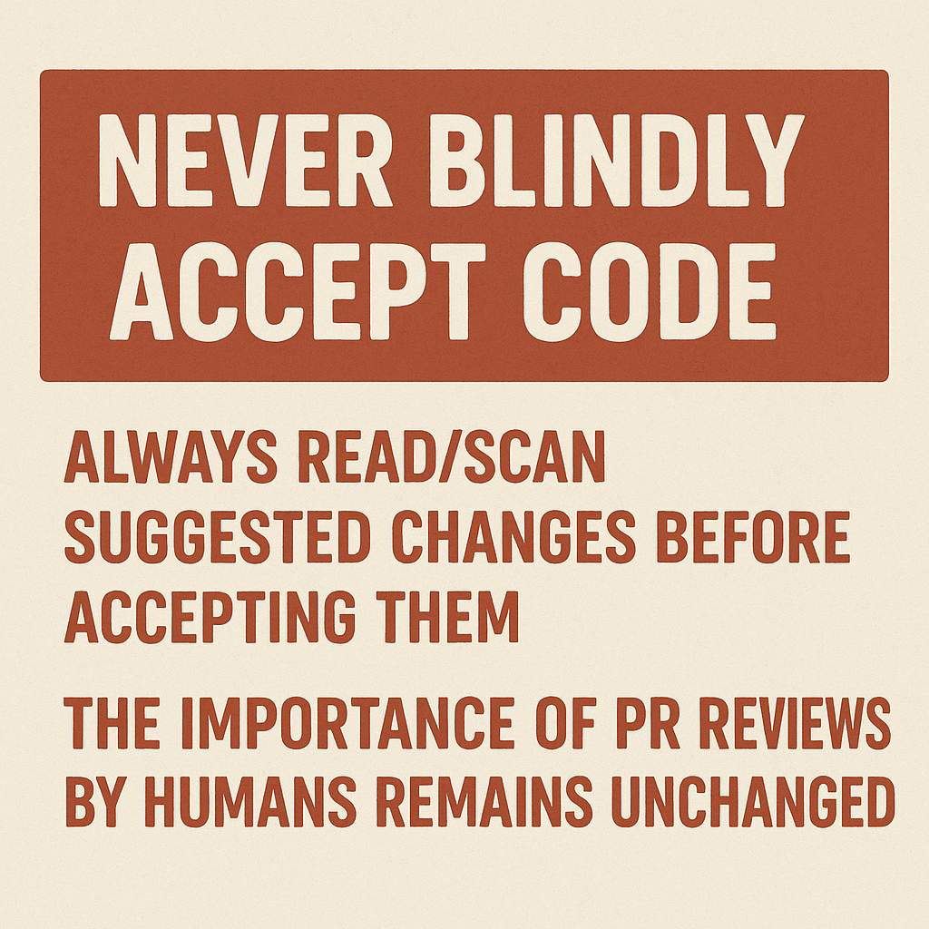

Slide 38

Getting Started: AI Coding
Begin with Cursor or Windsurf IDEs.
Try Claude Code within VS Code terminal.
Experiment with multiple AI coding tools in parallel.

Slide 39
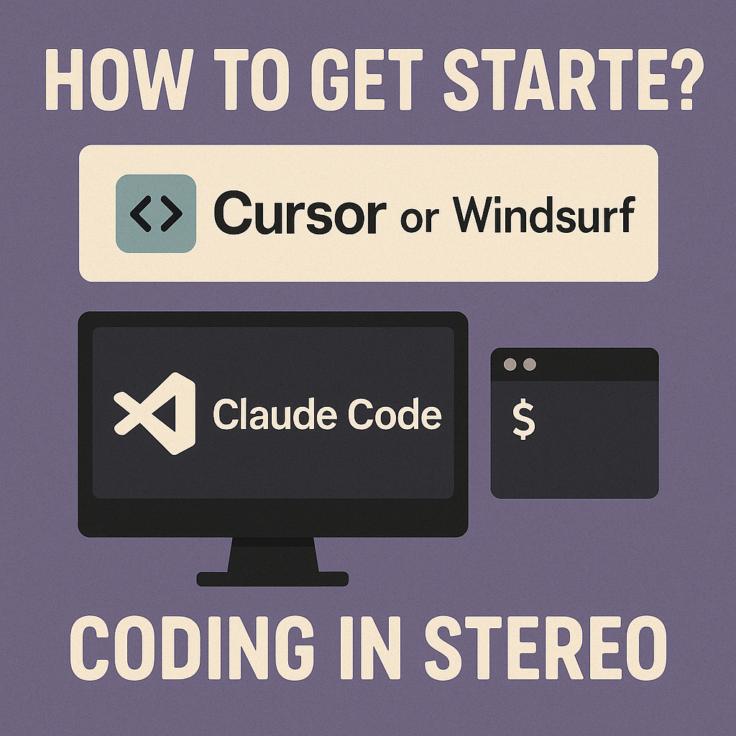

Slide 40

Emerging AI Coding Tool Overload
AI tool landscape is rapidly evolving with new releases.
Google's Jules assists in updating GitHub repository packages.
Keeping up with new AI coding tools is challenging task.
High demand for Google's Jules tool outpaced initial supply.
Emerging AI coding tools continually change development workflow.

Slide 41
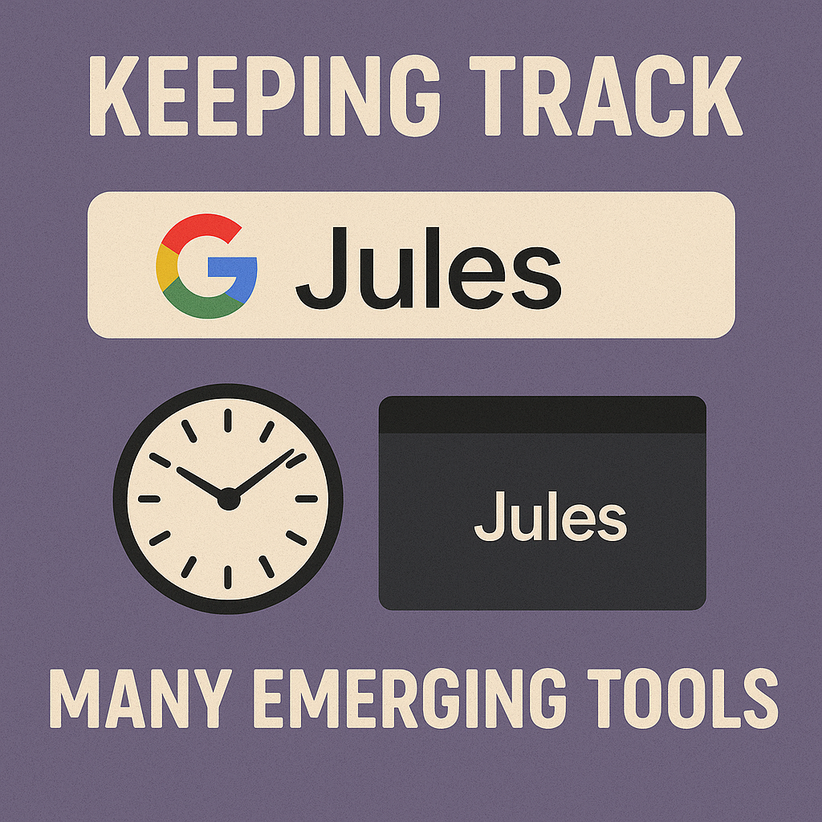

Slide 42

AI Coding: Secure, Smart, Strategic
Maintain code privacy, avoid excessive context in public chats.
Need to check which tools have what privacy conditions.
Free AI chats often collect personal data.
We’re working on AI coding guidelines.

Slide 43
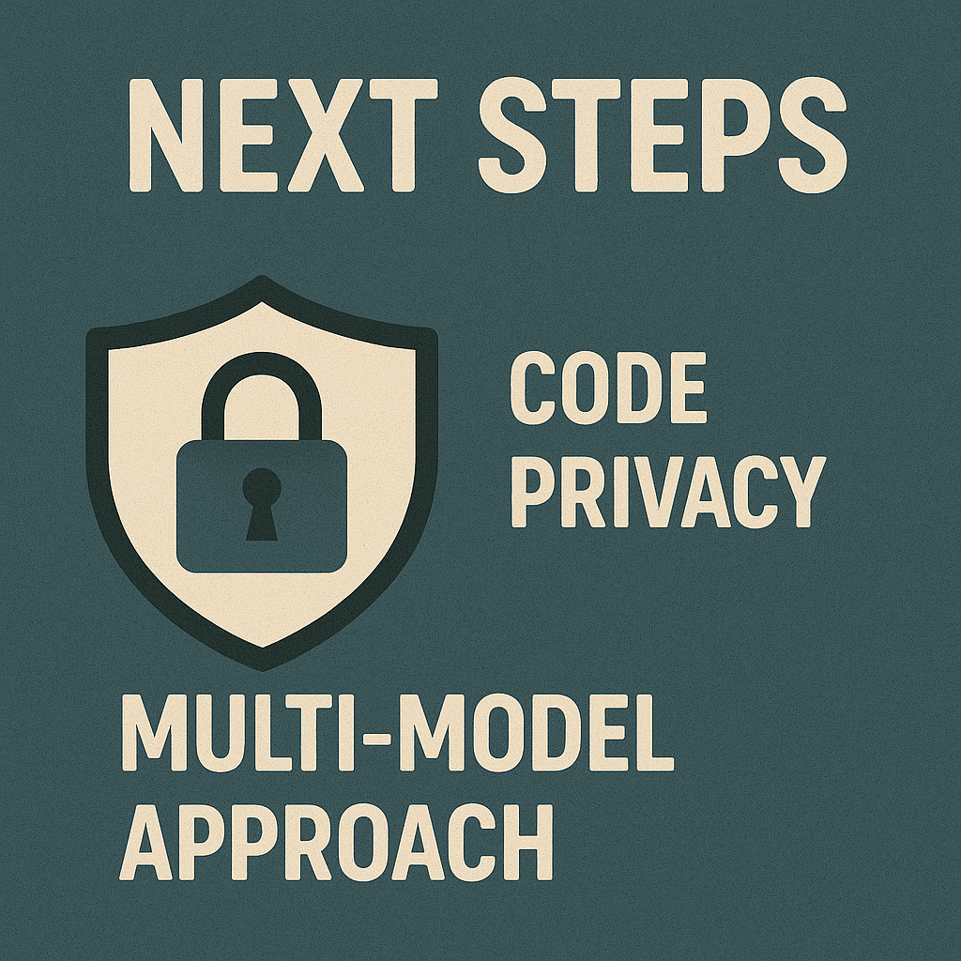

Slide 44

AI Coding: Key Takeaways
AI tools are changing software engineering rapidly.
Careful review of AI code is essential.
Experiment with different AI coding tools.
Balancing AI help and human expertise matters.
Choosing the right AI model is crucial.

Slide 45
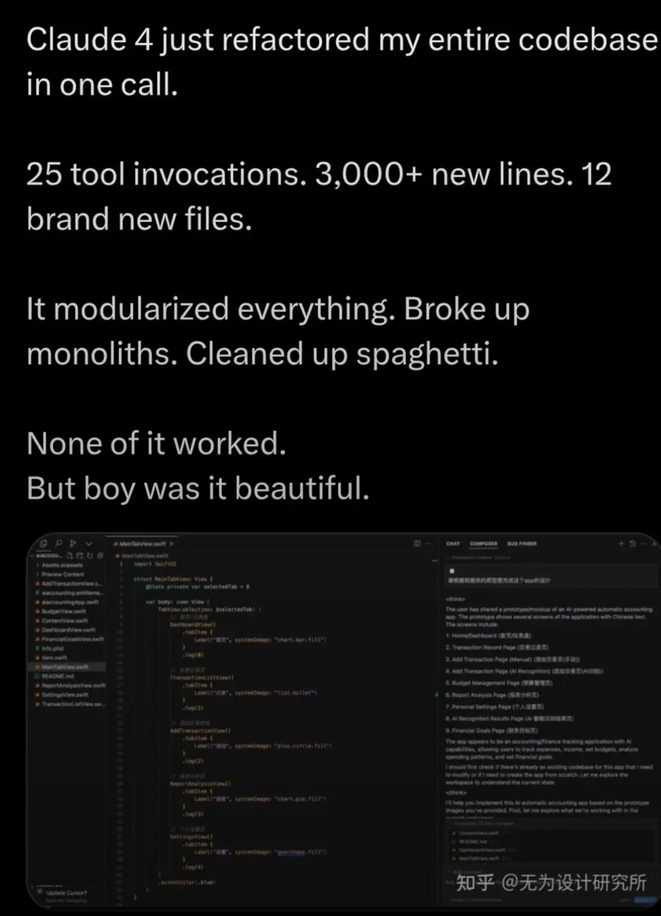
😎
🧐

Slide 46


